Slide 1
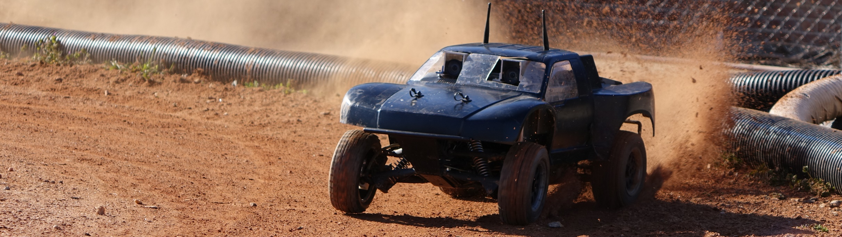
Autonomous RC (ARC)
Cierra Shawe, Tao Chen, Daniel Stoyer
Figure 1
Figure 1: image from https://autorally.github.io/
Notes:
Depends on how intelligent our system is: like a human driving a car doesn’t need to understand the steering ratio of the car. If the turning angle is too small, a human would just apply more steering. That requires a more sophisticated system.

Slide 2
Introduction
Winter Progress Report

Slide 3
Introduction
The purpose of the Autonomous RC (ARC) project is to determine if it is possible to build an autonomous RC vehicle using commodity components, meaning components that are relatively inexpensive and can be bought at places like Radio Shack®, Best Buy®, or on Amazon®.

Slide 4
Introduction
Our goal is to make an RC vehicle navigate autonomous to a given waypoint/location, preferably at a high rate of speed. Stretch goals are to make the vehicle drift around corners and parallel park.

Slide 5
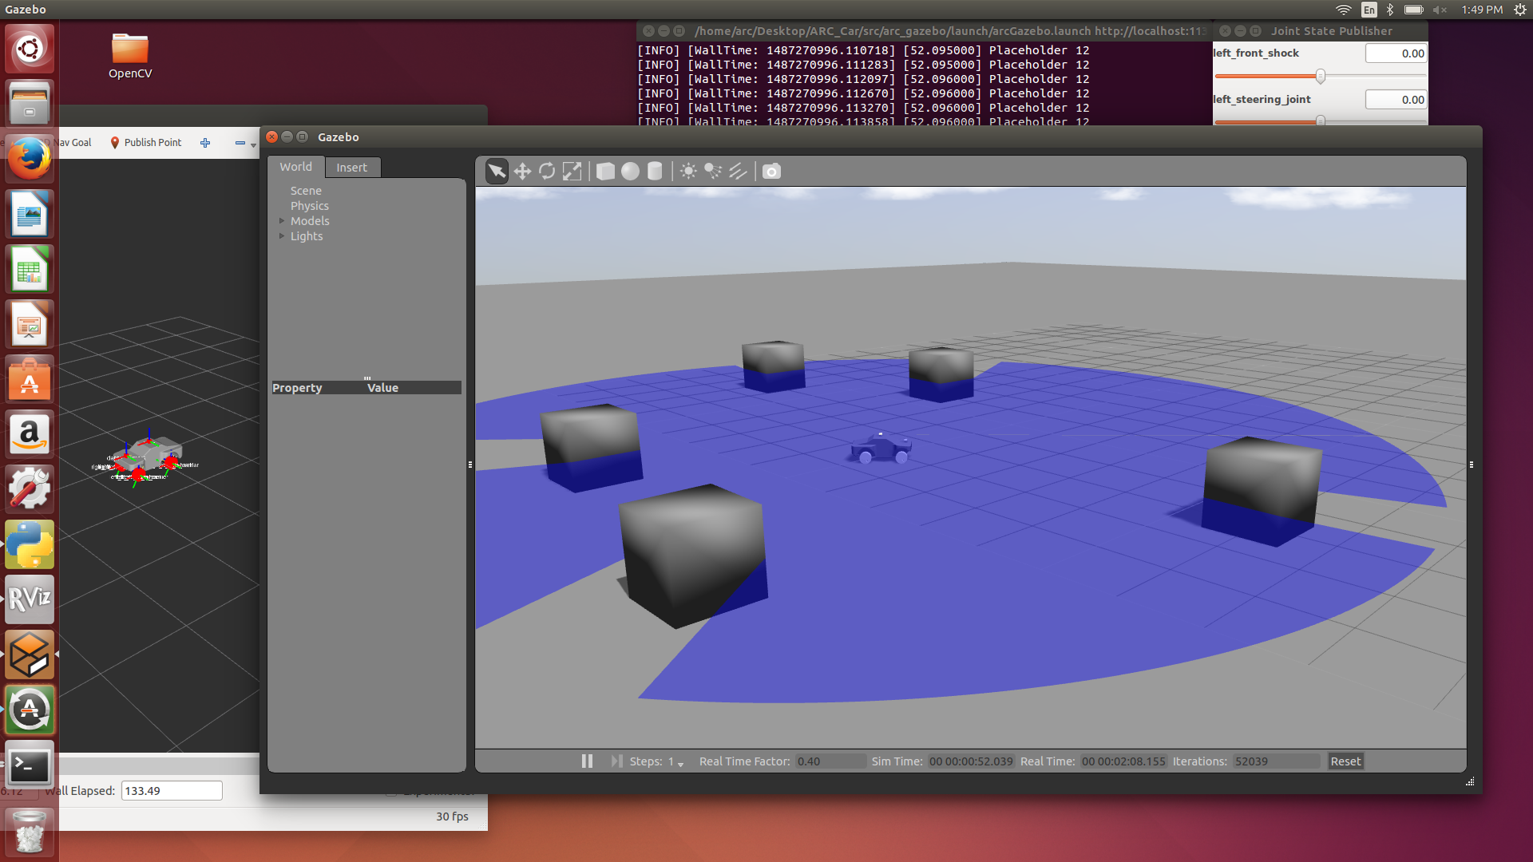
Simulation on Ros -Tao

Slide 6
Simulation on Ros -Tao
What simulation can do?
Visualization
Experimentation.
Testing

Slide 7
Simulation on Ros -Tao
Why simulation?
Makes development go faster.
Can avoid potential hazard.
Makes it easier for testing.
AutoRally already has a huge amount of code that we can use.

Slide 8
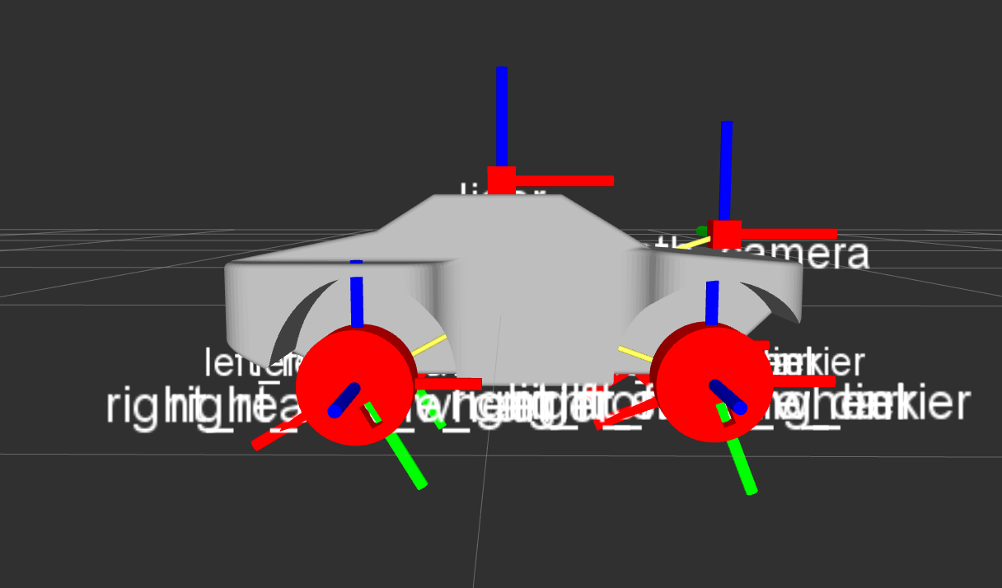
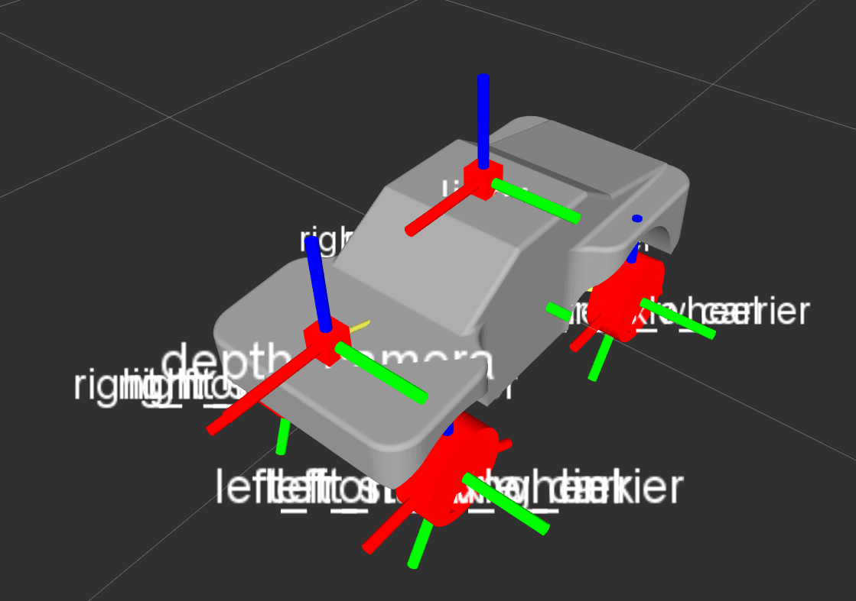
Simulation on Ros -Tao
The URDF model being displayed on Rviz

Slide 9
Simulation on Ros -Tao
Next
I need to get the car moving without using a controller
Integrate the state estimator, the waypoint follower and the constant speed controller from AutoRally.
Setup simple obstacle avoidance.

Slide 10
Environment Set Up - Dan
Computers to talking to each other directly over Ethernet.
Autopilot (Rasberry Pi 3 (RPi3) and PXFmini) talking with other computers.
ROS publisher/subscriber functionality.
PXFmini launched and armed!
RPi3 connected to the internet.

Slide 11
ROS publishing/subscribing - Dan
Ran python script publishing to a ROS topic.
Command line execution publishing and subscribing to ROS topics. ROS publisher/subscriber functionality.
ROS publisher/subscriber functionality.

Slide 12
AutoPilot (PXFmini)- Dan
Installed Erle image for Raspberry Pi 3
Delayed due to manufacturer.
First image was corrupted.
Took several attempts to correctly install.

Slide 13
AutoPilot (PXFmini)- Dan
Launches and Arms!
Sends IMU data.
Still need to get motors working.

Slide 14
What’s Next?- Dan
Now that our environment is nearly set up, I will start focusing on:
Image analysis
Use the information from Tao’s simulation work to start testing our environment mapping module.
Radio Communication
Transmit telemetry to our GCS and send commands to the RPi3
User Interface
Install a GUI for vehicle control (ArduPilot/QGroundControl) on the GCS.
Create custom python scripts for commands we will need to execute on a CLI.
Integrate all of the above to work toward autonomous RC navigation.

Slide 15
Cierra
RTABmap point cloud
Stereo Vision Mount and Calibration*
Modeled the mount in CAD (version 1), Printed the mount, Assembled the mount, and Calibrated* the two cameras using OpenCV
Adapted UM7 IMU to communicate through serial to USB
Obtained hardware and software required
Researched the Leddar M16

Slide 16
Creating a Point Cloud with RTABmap
Used Microsoft Kinect
Able to map the capstone room into a 3D point cloud
Great for indoors, doesn’t work outdoors due to the sun
Would work if the RC car was going to stay indoors or only run on cloudy days
Only has a 15-30ft range

Slide 17
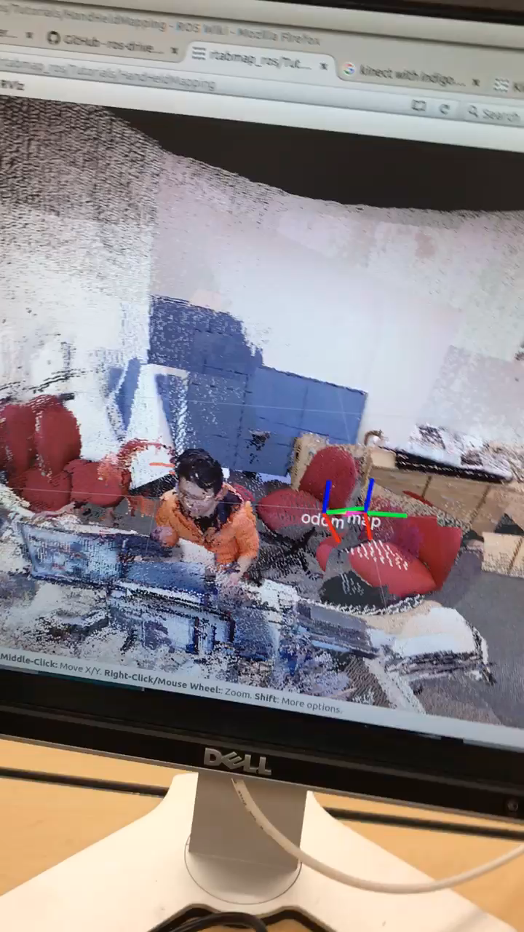

Slide 18
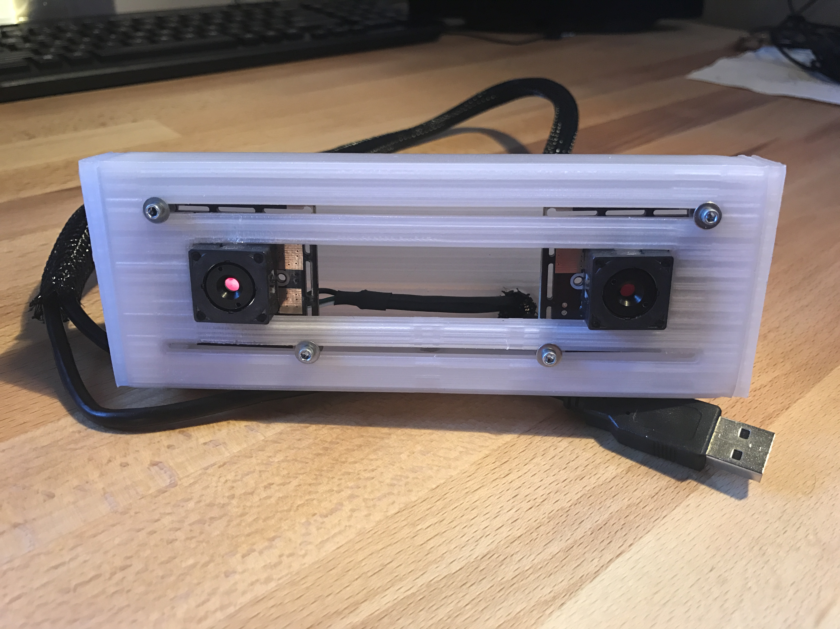
Stereo Vision Mount

Slide 19
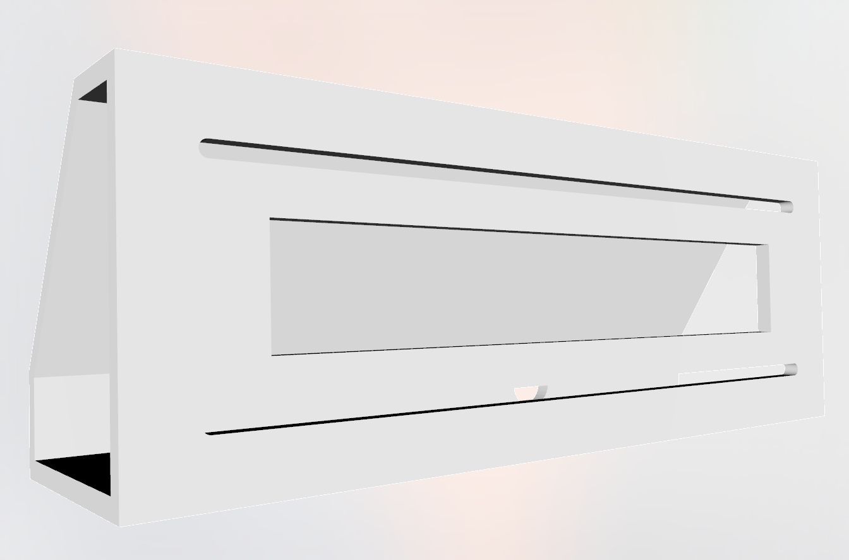
Modeling the Stereo Mount v1 in CAD
Designed using Solid Works
4 pieces in total (minus hardware)
Attaches to Go Pro style Mount
Adjustable Camera Distance
Press-fit Caps
3/8” Hole in back for wires

Slide 20
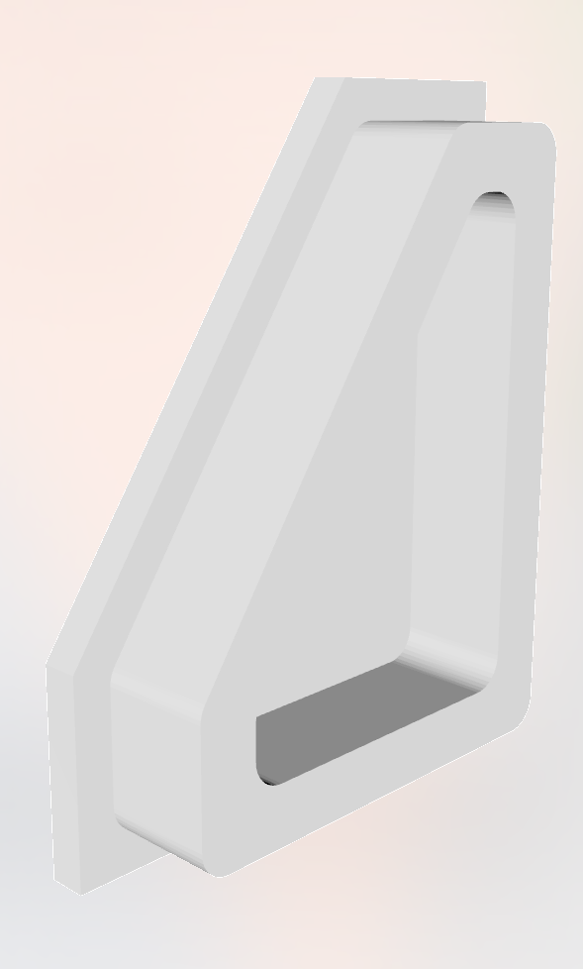
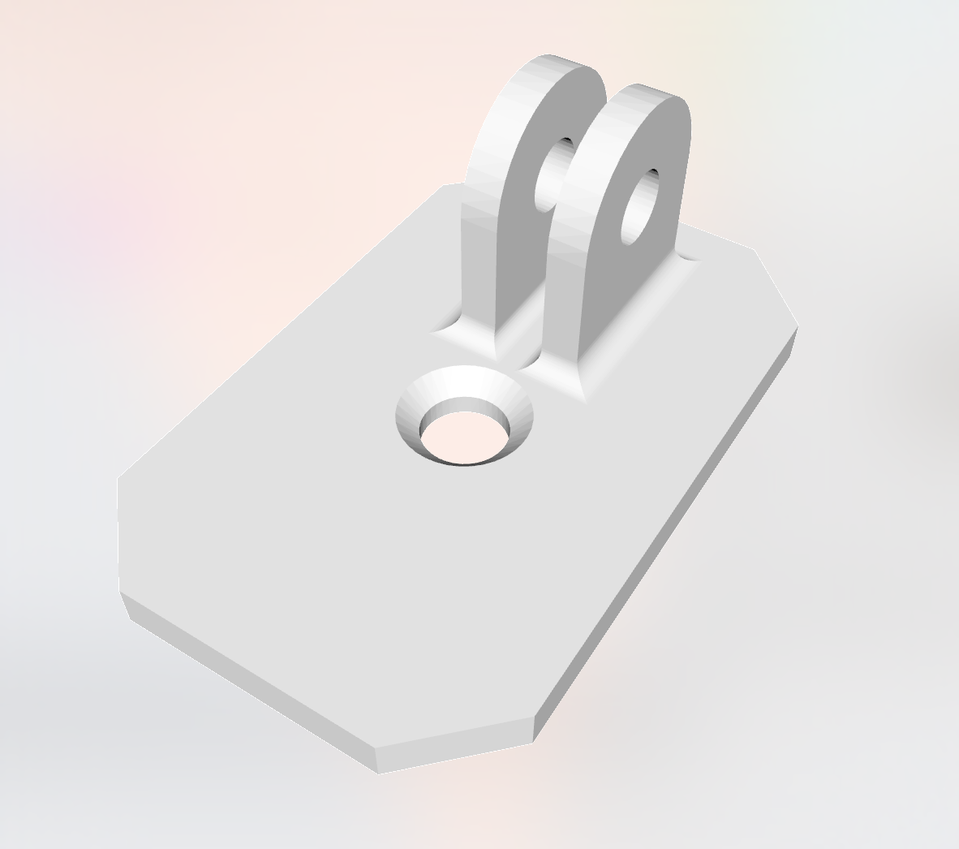
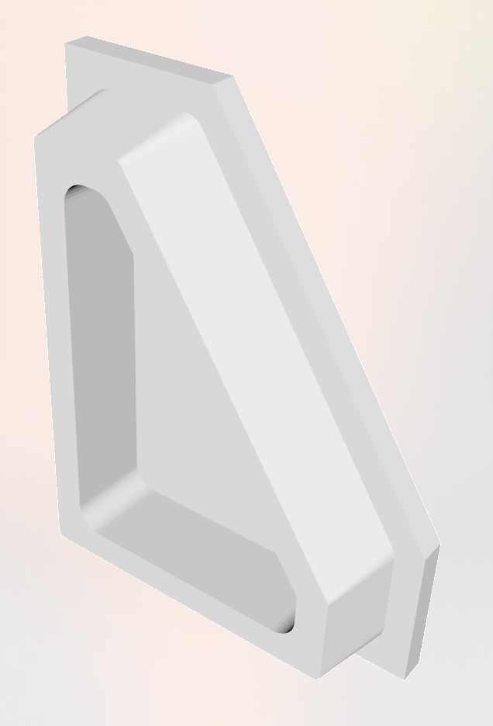

Slide 21
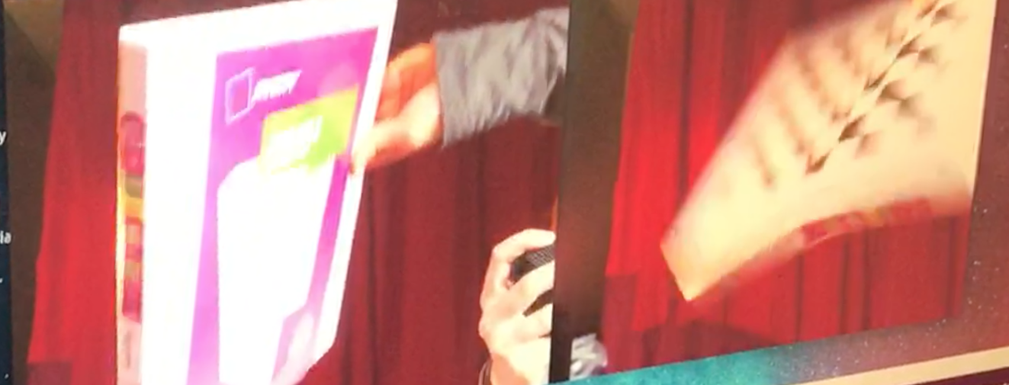
Problems with the Stereo Camera

Slide 22
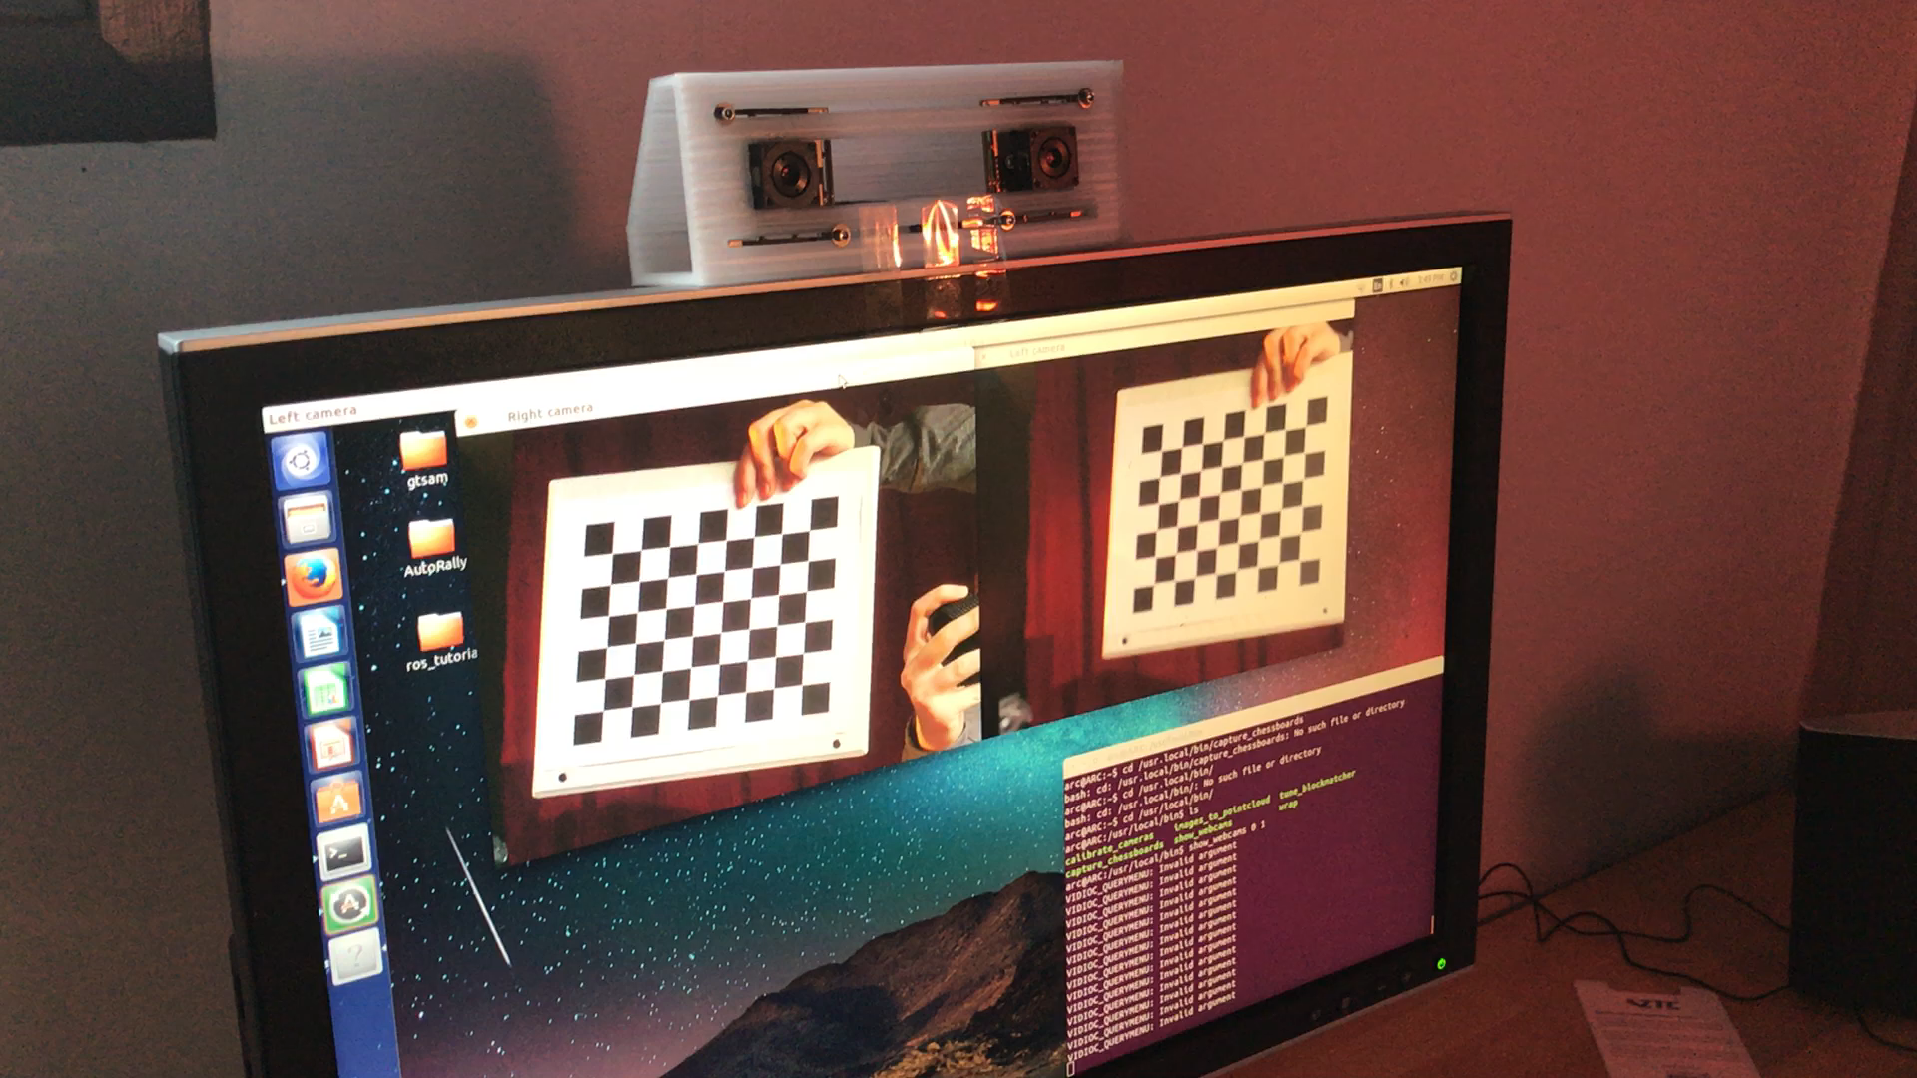

Slide 23
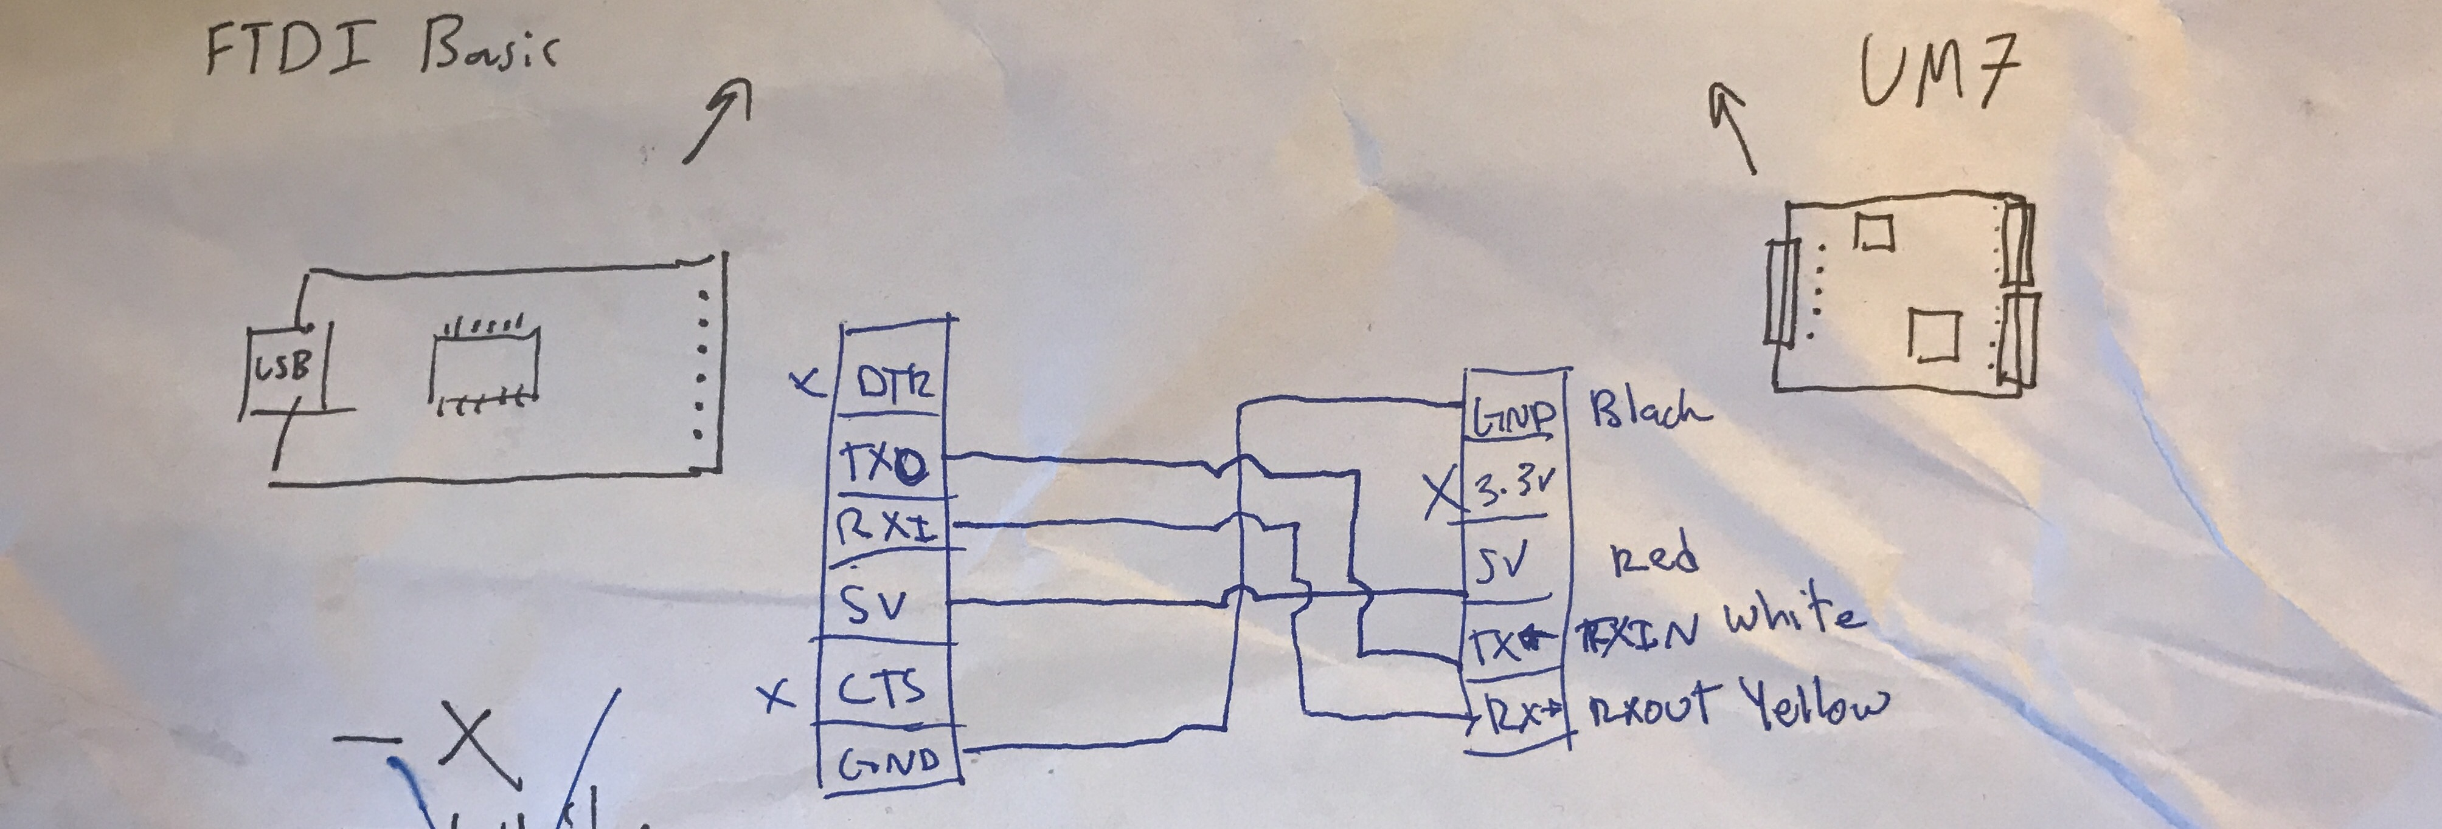
Wiring and Testing the IMU

Slide 24
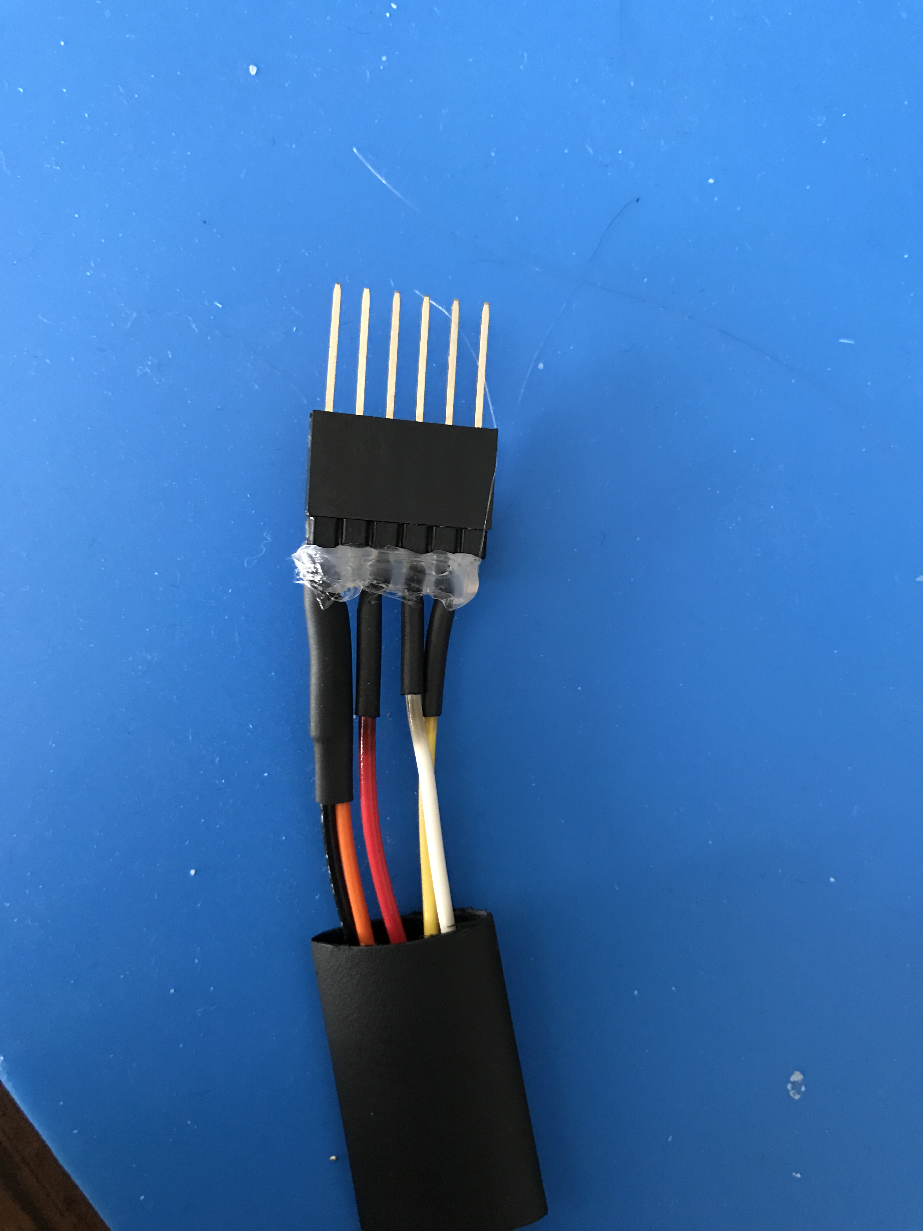
Wiring the IMU
Serial connection
6 pin header
All wires heat-shrinked to header pins
Hot glue to keep pins from moving around and to maintain durability

Slide 25
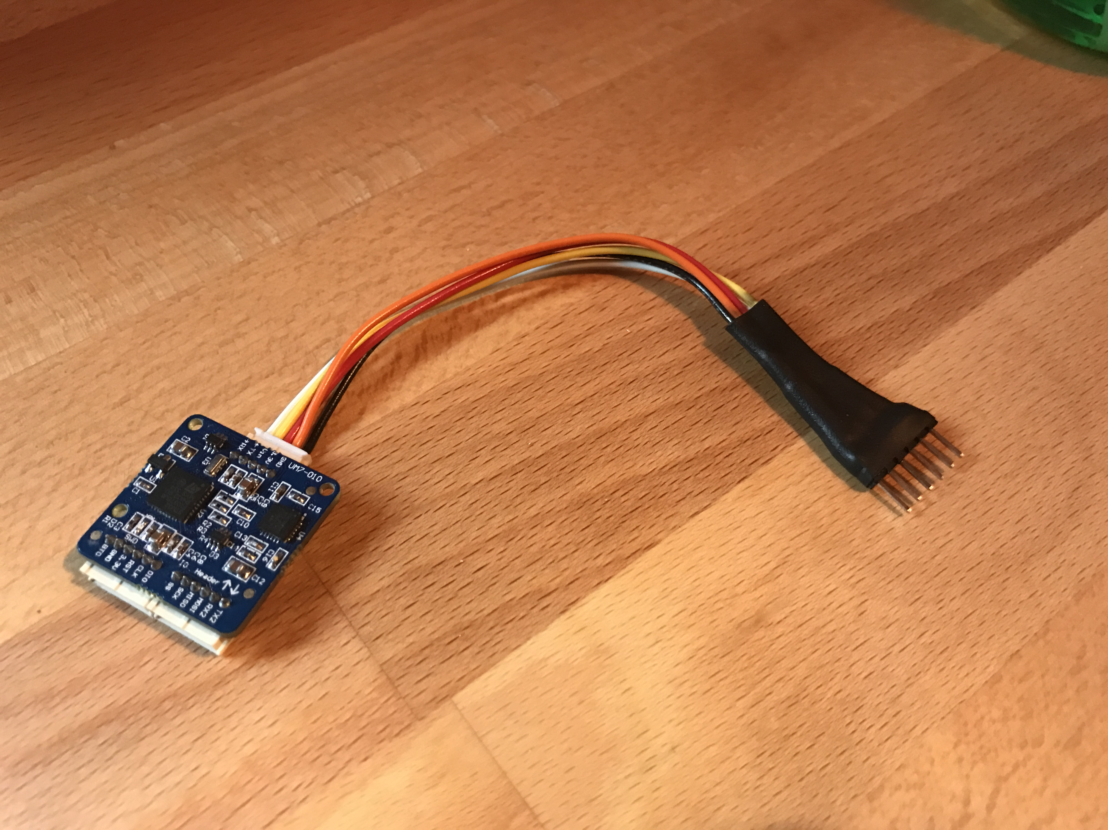
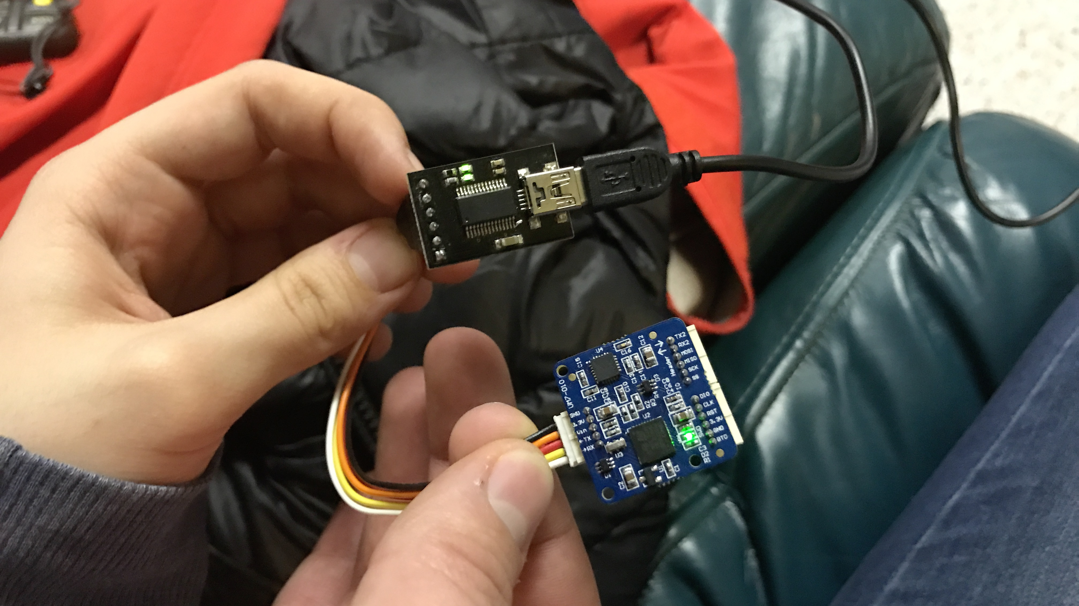
Finished Product

Slide 26
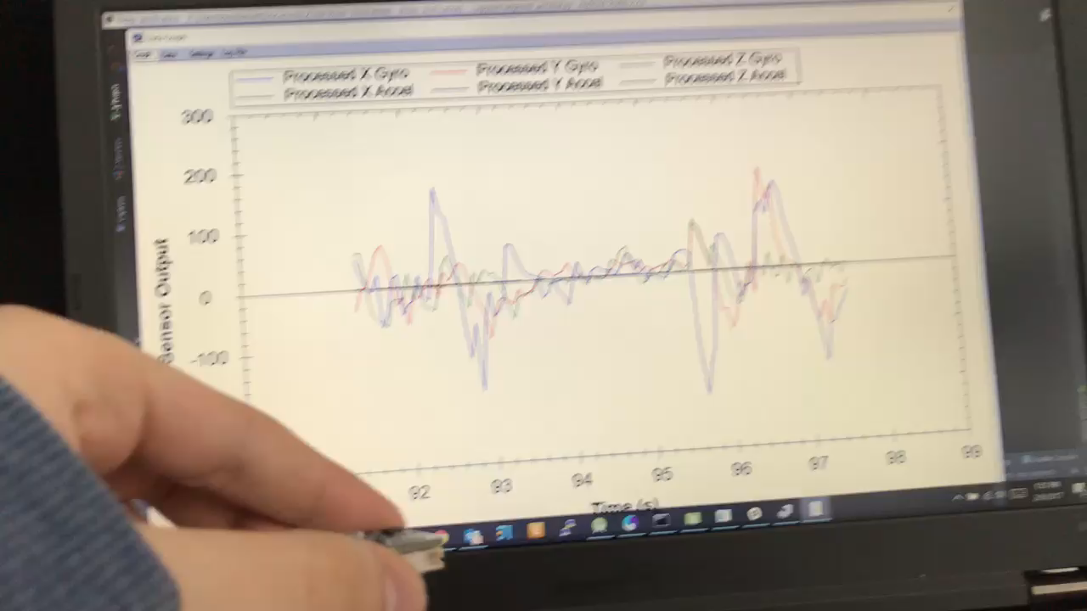

Slide 27
Acquiring Missing Hardware and Software
Acquired the following hardware:
3-cell LiPo battery to attempt to run NUC off, along with its charger
150W voltage step-up unit after having Kevin order it, to be used with LiPo and NUC
Raspberry Pi 3 (We had the Pi2, but Pi3 software)
Serial to USB cord for IMU
Similar speed controller and motor to the RC car to test our set-up
Acquired PXF-mini image, both a corrupt and ”working” copy

Slide 28
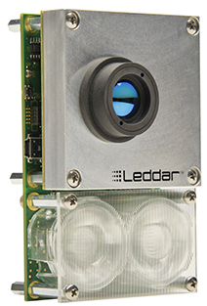
Leddar M16
A possible replacement for Stereo Vision

Slide 29
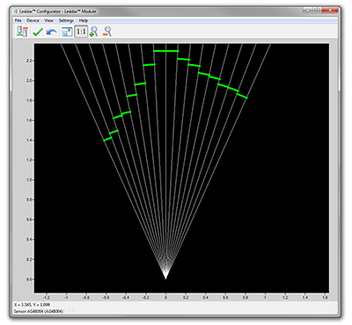
Benefits of the Leddar M16
16 segments with simultaneous acquisition
50m range
Low power consumption
Immune to ambient light

Slide 30
Conclusion
What have we learned and what is next?

Slide 31
What We Have Learned
When someone says something should “just work,” that doesn’t mean it will “just work”

Slide 32
Next Steps
Be able to control motor and servo
Power NUC via battery
Create hardware mounts
Send/Receive data via radio
Attach hardware onto car
Leddar object detection with obstacle avoidance

